Slide 1
Steering Angle Prediction in Autonomous Vehicle
Amulya Gunturu

Slide 2
Big Questions
What is the problem?
How was the data captured?
What are the inputs?
It is the most answered question in the market and what makes my project different?
How was the input dataset labeling and targets were incorporated?

Slide 3
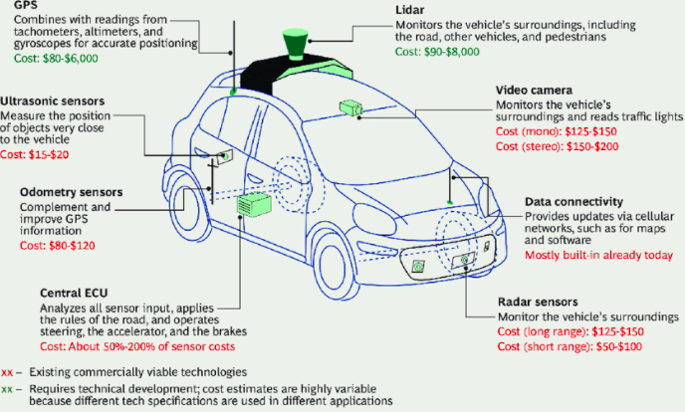
Self Driving car system

Slide 4
Problem
Computer with
Machine Learning Model
Front camera
Steering Angle

Slide 5
Data
Stored in Google Drive
Series of input images
Data.txt

Slide 6
Pre-processing the Data
Normalization: Converting radians into degrees.
Splitting the dataset
Training = 0.6, Validation = 0.2, Testing = 0.2
Distribution of the data.
Mostly the steering angle is zero degrees ( i.e., almost the steering is straight)
Most of the values lie between -2 to 2.

Slide 7
Baseline model
After looking at the normalized steering angle. I chose the baseline model where I am using the mean of steering angles in train data to predict the steering angles of test data.
Since it is a regression problem, the performance metrics is MSE and baseline model is mean-square of (test steering angles – mean train steering angles).

Slide 8
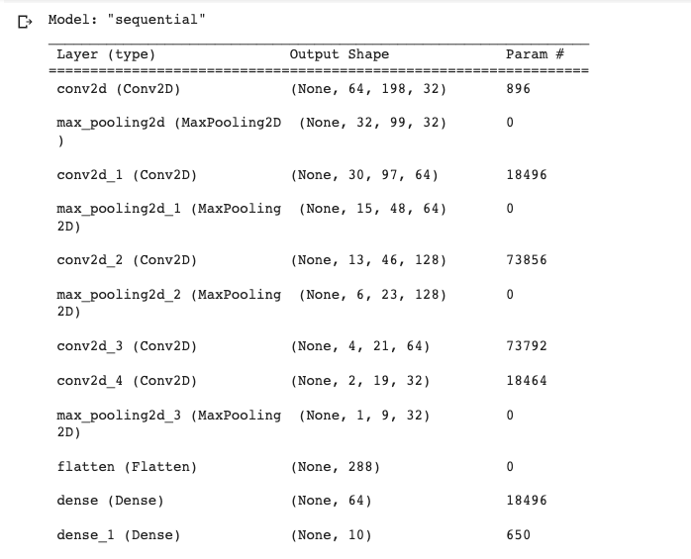
CNN Model

Slide 9
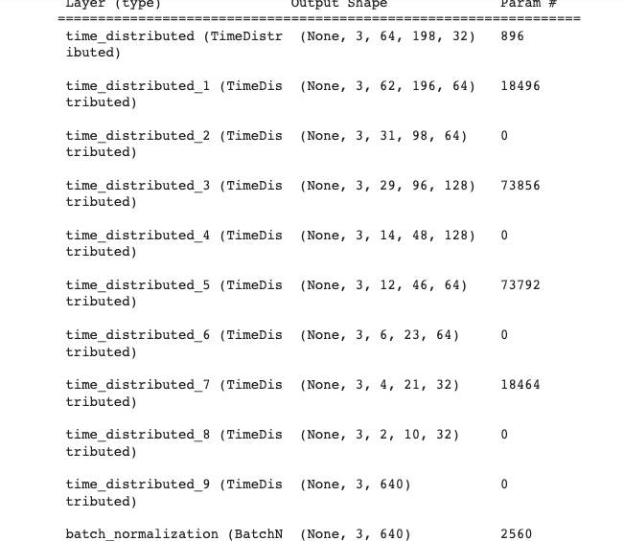
C-LSTM

Slide 10
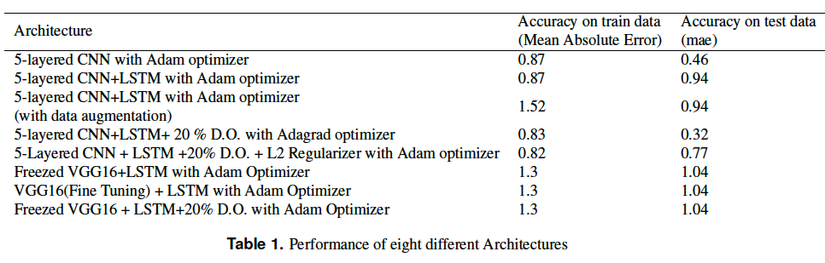
Different model architectures

Slide 11
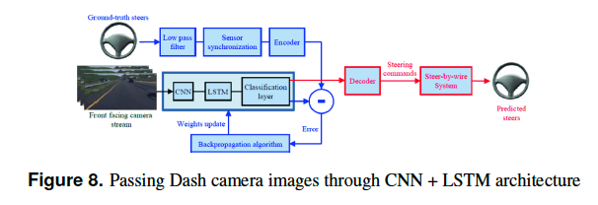
Why C-LSTM

Slide 12
Expectations
The C-LSTM is expected to be more accurate than CNN because it considers the sequence in the images.

Slide 13
Actual Results & Limitations
The model is not efficient enough in predicting the steering angle as the model is trained with only 3000 images i.e., less than a 2 minutes video as typical camera capture's 30 images in one second.
Overfitting a major issue
GPU and RAM major issue.

Slide 14
Questions?
Special Thanks to Dr. Eickholt

